Slide 1

AHB2APB Bridge
SANTHOSH B V
B-109

Slide 2
Introduction to AHB2APB

Slide 3
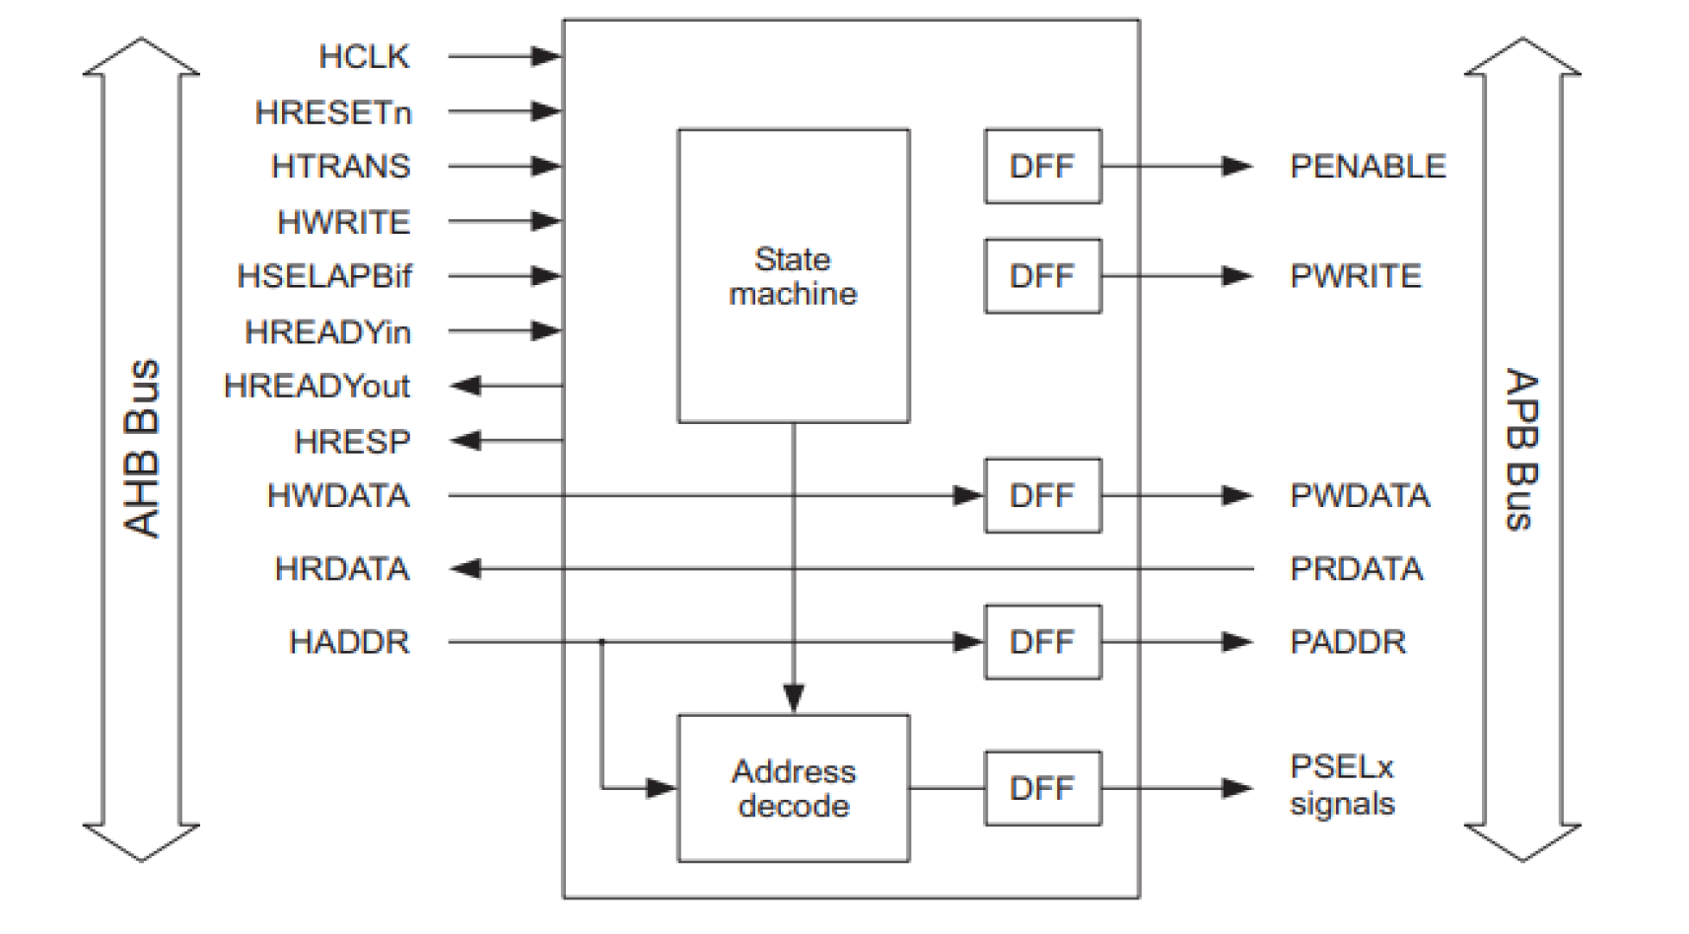
AHB to APB bridge provides an interface between the high-speed AHB and the low-power APB.
Read and write transfers on the AHB are converted into equivalent transfers on the APB.
It has an AHB slave bus interface, APB transfer state machine, which is independent of the device memory map, and APB output signal generation.
It buffers address, controls, and data from the AHB, drives the APB peripherals and returns data along with a response signal to the AHB.
Latches the address and holds it valid throughout the transfer.
Decodes the address and generates a peripheral select, PSELx.
Only one select signal can be active during a transfer.

Slide 4
AHB Protocol

Slide 5
AHB (Advanced High-performance Bus) is part of the ARM AMBA (Advanced Microcontroller Bus Architecture) family of buses designed for high-performance communication between components in a system-on-chip (SoC) such as CPU, on-chip RAM, processors, DMA controllers, and memory interfaces.
AHB supports the efficient connection of processors, on-chip memories and off-chip external memory interfaces with low-power peripheral devices.
Supports burst transfers and pipelining, optimizing data throughput and reducing latency.
Features
High performance
Pipelined operation
Burst transfers
Multiple bus masters
Split transactions

Slide 6
APB Protocol

Slide 7
APB (Advanced Peripheral Bus) is a part of the AMBA (Advanced Microcontroller Bus Architecture) protocol family designed for low-bandwidth, low-power peripherals like UARTs, GPIOs, and timers.
APB follows a simple interface with a master-slave communication model. The master initiates all operations, and the slave responds, ensuring straightforward implementation.
Simple design with a non-pipelined structure.
Single-cycle setup and single-cycle access for minimal power usage.
No burst or out-of-order transactions, making it ideal for simple peripherals.
Features
Low power
Latched address and control
Simple interface
Suitable for many peripherals

Slide 8
Signal Description

Slide 9
AHB:
HCLK: Clock signal for the AHB interface.
HRESETn: Active-low reset signal for the AHB interface.
HSIZE[2:0]: Size of the transfer on the AHB interface.
HADDR[31:0]: Address for the AHB transfer.
HTRANS[1:0]: Transfer type on the AHB interface.
HWRITE: Write enable signal for the AHB interface.
HRESP[1:0]: Response indicating the status of the AHB transfer.
HBURST[2:0]: Busrt Type on the AHB Interface
HWDATA[31:0]: Write data on the AHB interface.
HRDATA[31:0]: Read data from the AHB interface.
HREADYin: Ready signal indicating the availability of the AHB interface.
HREADYout: Ready signal indicating the readiness of the AHB interface.
APB:
PSEL[2:0]: Slave select signal on the APB interface.
PENABLE: Enable signal for the APB interface.
PADDR[31:0]: Address for the APB transfer.
PWRITE: Write enable signal for the APB interface.
PWDATA[31:0]: Write data on the APB interface.
PRDATA[31:0]: Read data on the APB interface.

Slide 10
Read & Write Operation

Slide 11
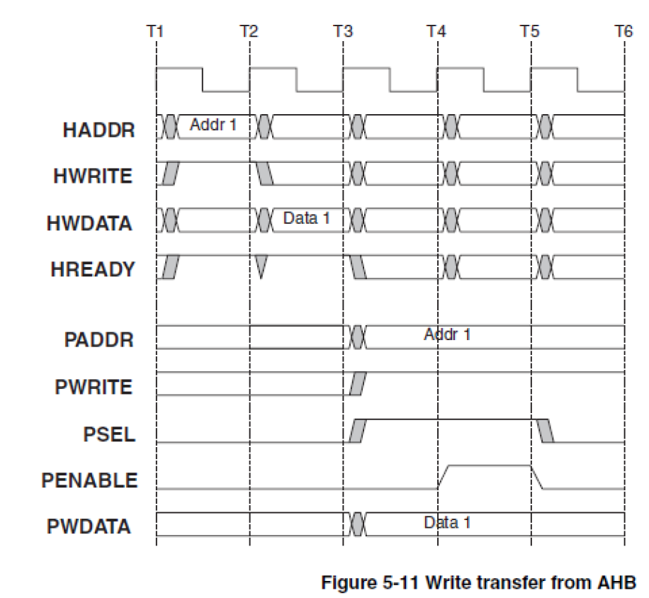
Write Transfer
An AHB transfer consists of two distinct sections:
The address phase, which lasts only a single cycle.
The data phase, which may require several cycles. This is achieved using the HREADY signal.
HWRITE - High for Write.
HREADY - AHB asserted for two cycles.
PSEL - Asserted for two cycles along with PWRITE starting in T4 - Enter SETUP.
PENABLE is asserted in T5, the cycle after PSEL is asserted Enter ENABLE.
The following cycle, T6, PSEL and PENABLE deasserted. - Single Read.

Slide 12
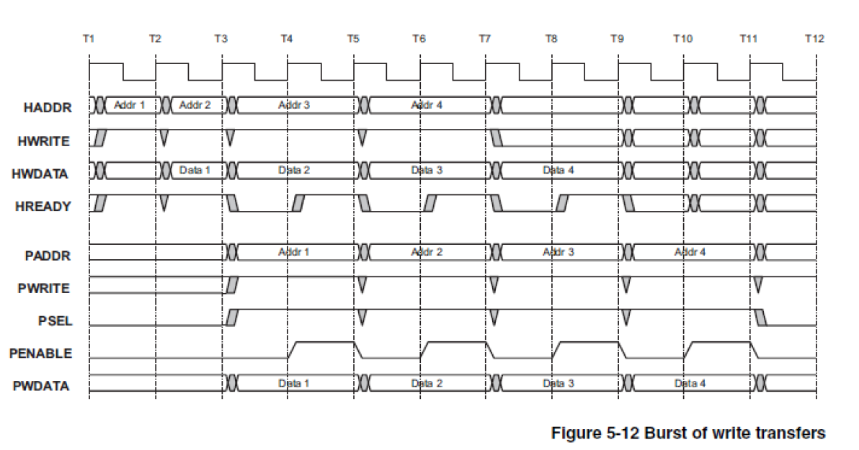
Burst of Write Transfers
HWRITE - Held high for Seq Write
HREADY - AHB asserted with HWRITE then strobed during burst
PWRITE - Low in T2, after AHB asserts HREADY
PSEL - Asserted along with PWRITE - Enter SETUP
PENABLE is asserted in T3, the cycle after PSEL is asserted - Enter ENABLE
The following cycle, T4, PENABLE deasserted. Cycles high and low for burst
PSEL held high for burst

Slide 13
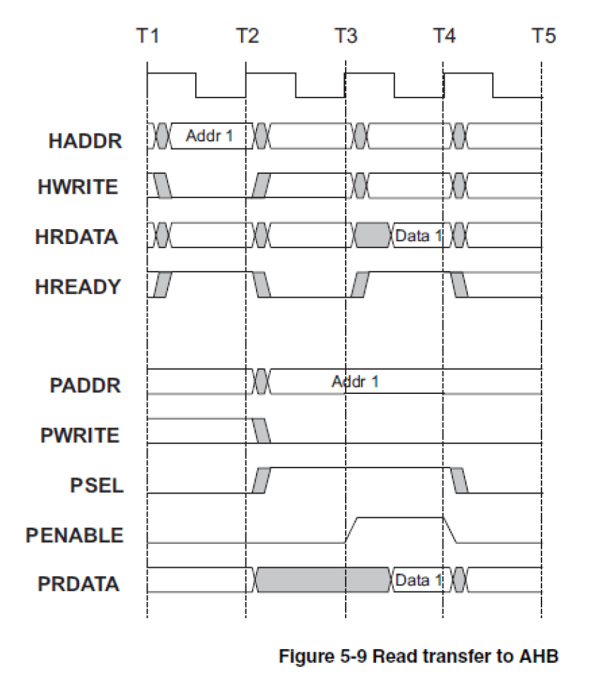
Read transfer
HWRITE - Low for Read
HREADY - AHB asserted with HWRITE then strobed once
PSEL - Asserted for two cycles along with PWRITE starting in T3 - Enter SETUP
PENABLE is asserted in T4, the cycle after PSEL is asserted - Enter ENABLE
The following cycle, T5, PSEL and PENABLE deasserted. - Single Read

Slide 14
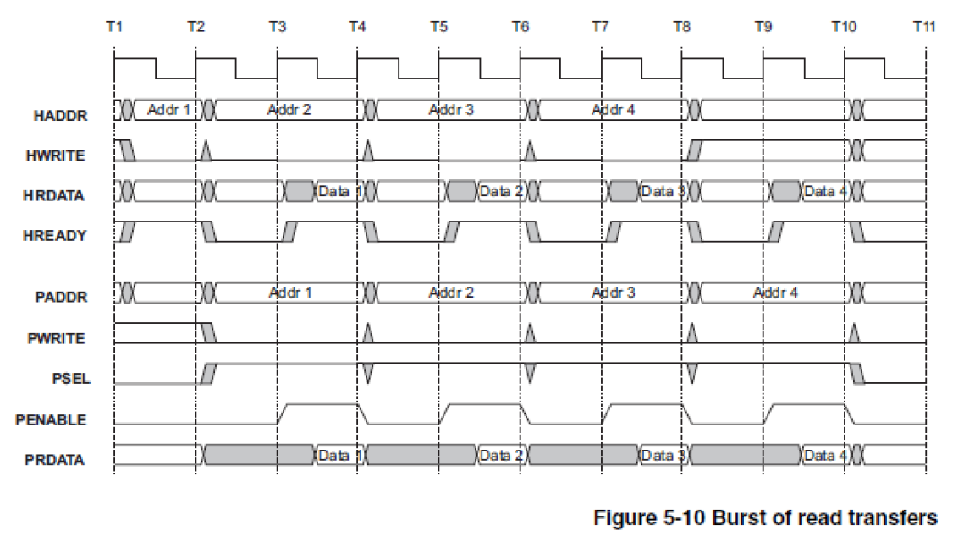
Burst of Read Transfers
HWRITE - Held low for Seq Read
HREADY - AHB asserted with HWRITE then strobed during burst
PSEL - Asserted along with PWRITE in T3 - Enter SETUP
PENABLE is asserted in T4, the cycle after PSEL is asserted - Enter ENABLE
The following cycle, T5, PENABLE deasserted. Strobed for burst
PSEL held high for burst

Slide 15
TB Environment

Slide 16
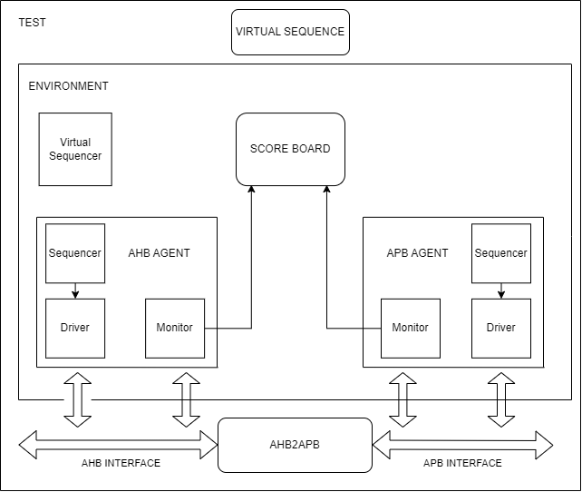

Slide 17
Thank You

